Slide 1


Slide 3
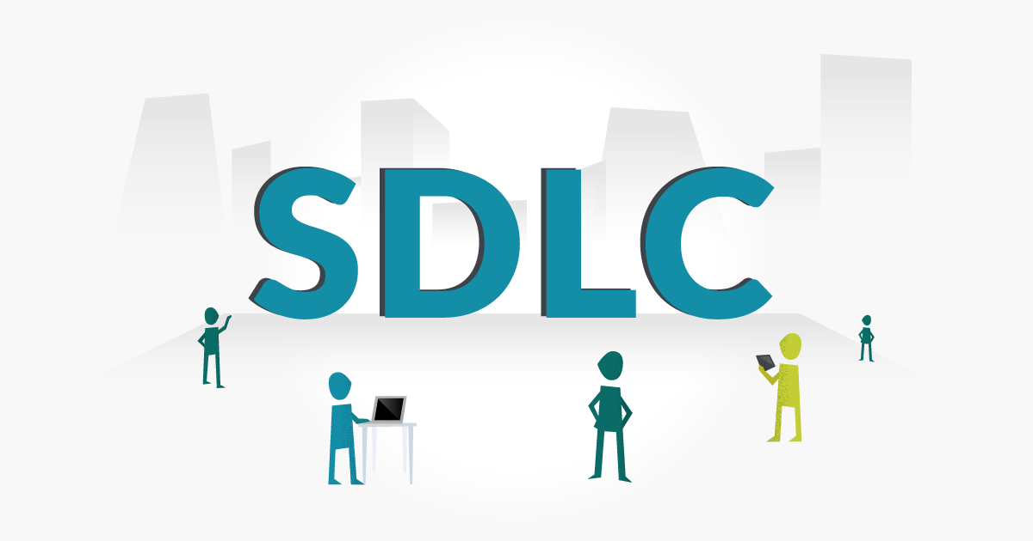
MODELS

Slide 4
MODELS
Waterfall Model
V-Shaped Model
Prototype Model
Spiral Model
Agile Model
Incremental model

Slide 5
WATERFALL MODEL

Slide 6
STRENGTHS
✓ Easy to understand , easy to use
✓ Provides structure to inexperienced staff
✓ Milestones are well understood
✓ Sets requirements stability
✓ Good for management control ( plan , staff , track )
✓ Works well when quality is more important than cost or schedule

Slide 7
WEAKNESS
✓ All requirements must be known upfront
✓ Inhibits flexibility
✓ Can give a false impression of progress
✓ Does not reflect problem - solving nature of software development
✓ Integration is one big bang at the end
✓ Little opportunity for customer to preview

Slide 8
V-MODEL

Slide 9
STRENGTHS
✓ Emphasize planning for verification and validation
✓ Each deliverable must be testable
✓ Project management can track progress by milestones
✓ Easy to use

Slide 10
WEAKNESS
✓ Does not easily handle concurrent events
✓ Does not handle iterations or phases
✓ Does not easily handle dynamic changes in requirements
✓ Does not contain risk analysis activities

Slide 11
Prototype Model

Slide 12
STRENGTHS
✓ Customers can " see " the system requirements
✓ Developers learn from customers
✓ Amore accurate end product
✓ Unexpected requirements accommodated
✓ Allows for flexible design and development
✓ Steady , visible signs of progress produced
✓ Interaction with the prototype stimulates awareness of additional needed functionality

Slide 13
WEAKNESS
✓ Tendency to abandon structured program development for " code - and - fix " development
✓ Bad reputation for " quick - and - dirty " methods
✓ Overall maintainability may be overlooked
✓ The customer may want the prototype delivered
✓ Process may continue forever ( scope creep )

Slide 14
SPIRAL MODEL

Slide 15
STRENGTHS
✓ Provides early indication of risks
✓ Users see the system early because of rapid prototyping tools
✓ Critical high - risk functions are developed first
✓ The design does not have to be perfect
✓ Users can be closely tied to all lifecycle steps
✓ Early and frequent feedback from users
✓ Cumulative costs assessed frequently

Slide 16
WEAKNESS
✓ Time spent for evaluating risks too large
✓ Time spent planning , resetting objectives , doing risk analysis and prototyping may be excessive
✓ The model is complex
✓ Risk assessment expertise is required
✓ Spiral may continue indefinitely
✓ Developers must be reassigned

Slide 17
AGILE MODEL

Slide 18
STRENGTHS
✓ High flexibility of the project
✓ High customer satisfaction over the development process
✓ Constant interaction among the stakeholders
✓ Continuous quality assurance, attention to details

Slide 19
WEAKNESS
✓ Problems with workflow coordination
✓ Difficult planning at early stages
✓ Professional teams are vital
✓ Lack of long-term planning

Slide 20
INCREMENTAL MODEL

Slide 21
STRENGTHS
✓ Develop high - risk or major functions first
✓ Each release delivers an operational product
✓ Customer can respond to each build
✓ Uses " divide and conquer " breakdown of tasks
✓ Lowers initial delivery cost
✓ Initial product delivery is faster
✓ Customers get important functionality early Risk of changing requirements is reduced

Slide 22
WEAKNESS
✓ Requires good planning and design
✓ Requires early definition of a complete system
✓ Well - defined module interfaces are required
✓ Total cost of the complete system is not lower

Slide 23



